Slide 1
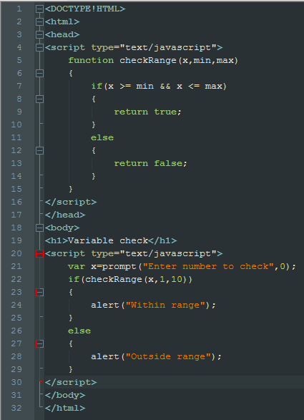
This will take 3 different values: a minimum value, a maximum value and the number it will check against the minimum and maximum values.
If it fits the parameters of the if statement, true will be returned, if not, false will be returned
This will see if x is higher than the minimum number and less than the maximum number “&&” means and.
The client will be prompted asking for a number to check whether or not they are within the min and max numbers
This will give the min and max a value, min is 1 and max is 10
If the number given within the prompt is within the parameters, you will be alerted with a message saying “Within range,” if not you will be alerted with the message “Outside range”

